Slide 1
Client query management system

Slide 2
Agenda
Introduction
Features
Tech Stack
Screen Shots

Slide 3

introduction
The Client Query Management System provides a seamless interface for clients to submit queries and for support teams to manage, track, and close them in real time.

Slide 4

features​
Login & Registration System
Query Submission (Client Side)
Support Team Dashboard

Slide 5
Tech Stack
Frontend : Streamlit
Backend : Python
Database : MySQL (mysql-connector-python)
Libraries : Pandas, datetime, hashlib
Auth : SHA-256 hashed passwords

Slide 6
Screen shots

Slide 7
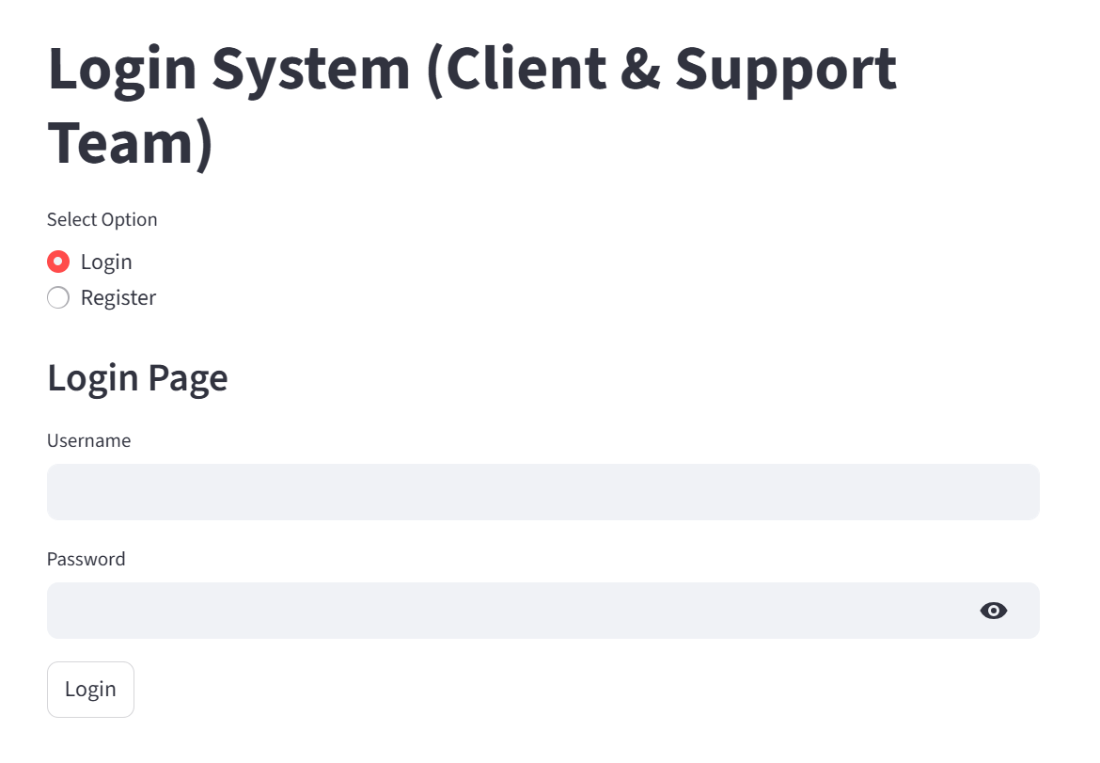
Login page​

Slide 8
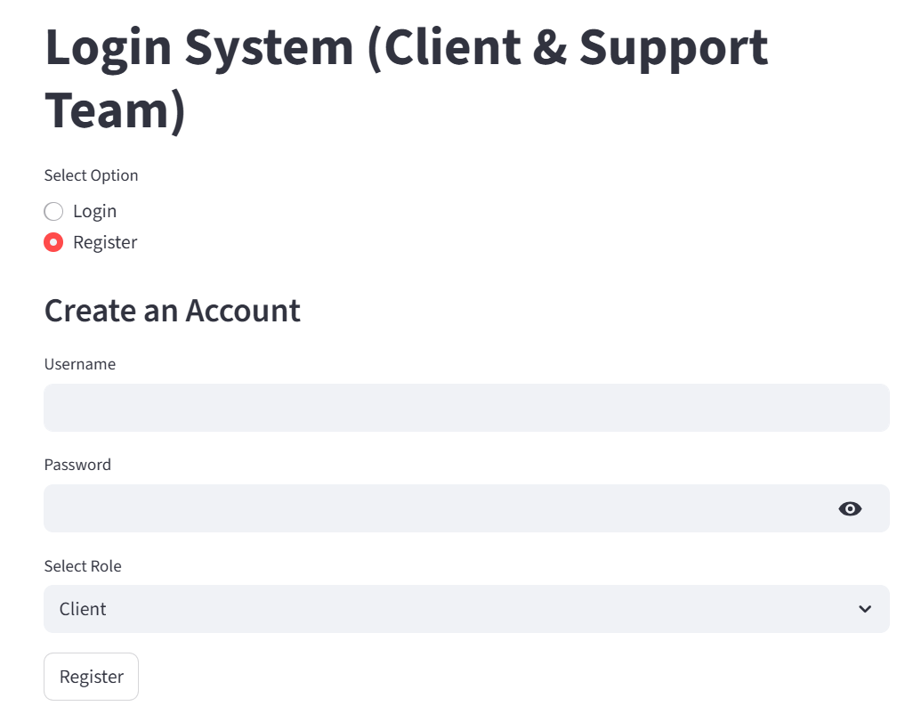
register page

Slide 9
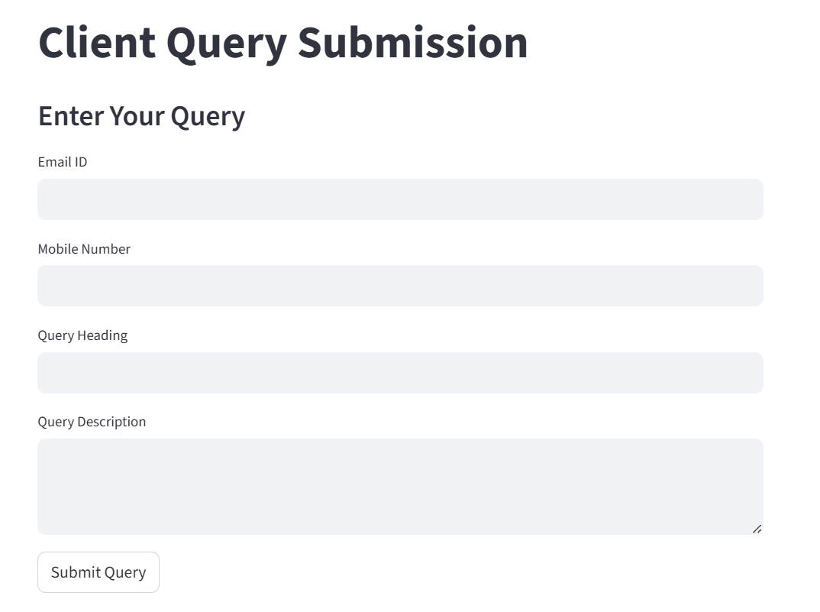
Client query page

Slide 10

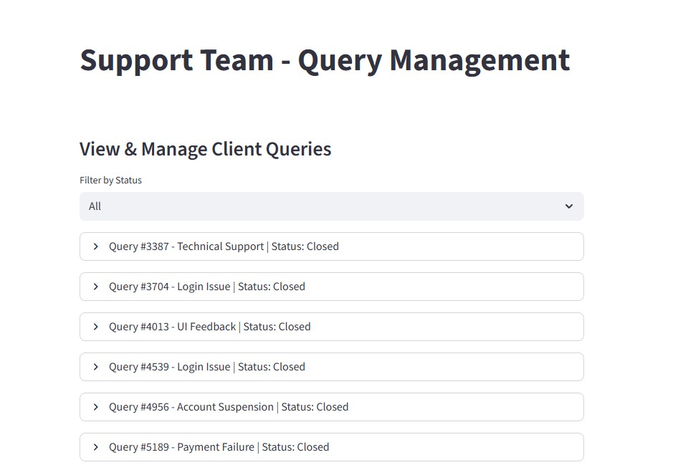
Support page​

Slide 11
THANK YOU
Shantha kumar S​

